Slide 1

WaterAPProval
Project presentation
Author:
Laura Schiatti, 904738
Design and Implementation of Mobile Applications (A.Y. 2019/2020) – Politecnico di Milano

Slide 2
ELEVATOR PITCH!
https://youtu.be/kHbYwKZ56fw

Slide 3

Context

Slide 4
Design

Slide 5
Overview
Principle of clean architecture:
“The goal is to keep core business logic separate from the UI,
database, network and third-party packages”
Main idea:
Define separate application layers for different areas of concern
UI
business logic
services

Slide 6
Overview
Principle of clean architecture:
“The goal is to keep core business logic separate from the UI,
database, network and third-party packages”
Main idea:
Define separate application layers for different areas of concern:
UI, business logic, services ➔ MVC design pattern

Slide 7



Other design decisions

Slide 8
External web-service APIs

Slide 9



Aquapp API 2.0
Google Maps API (v2)
HTML
CSS
JS
Invemar ICAM web service

Slide 10
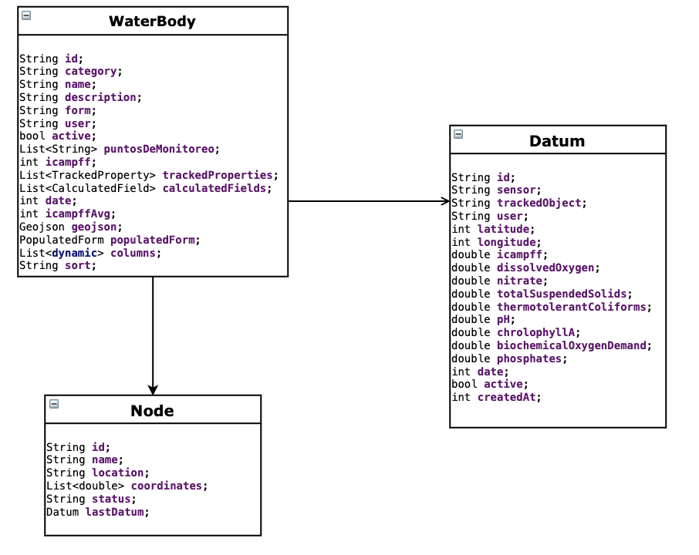
Local Data model

Slide 11
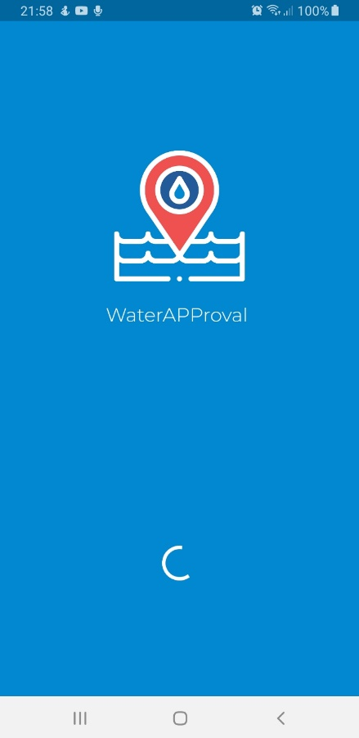

User interface

Slide 12
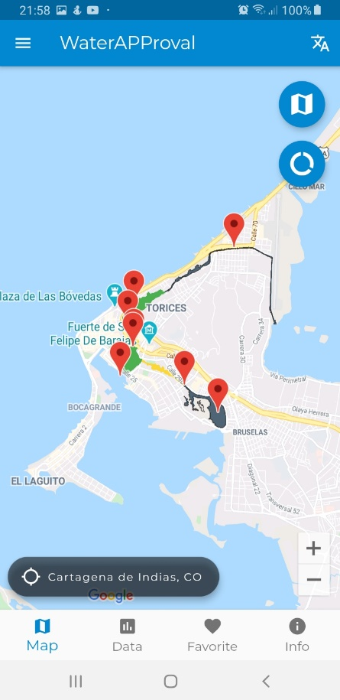
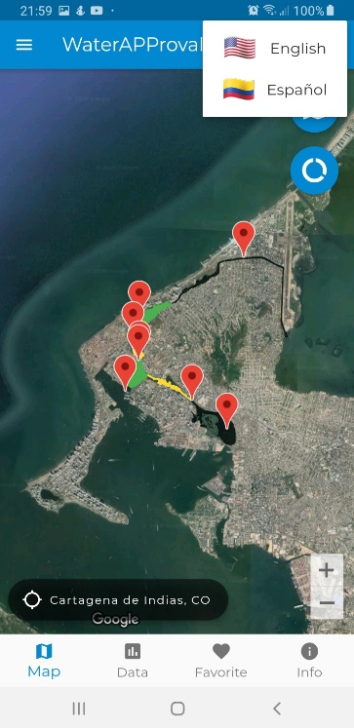
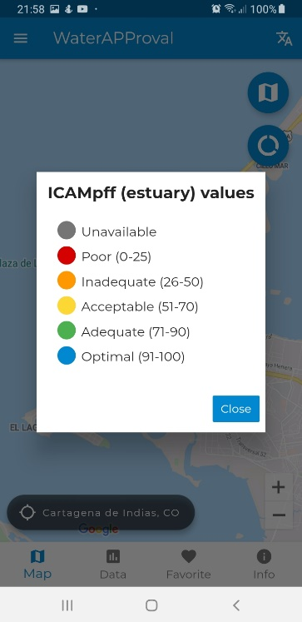
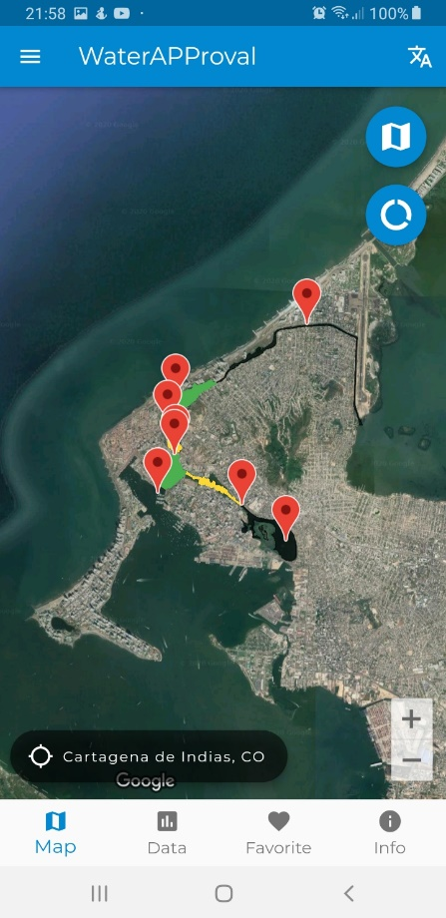
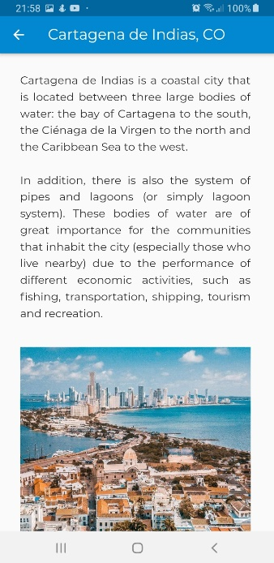
2
3
2
3
1
1

Slide 13
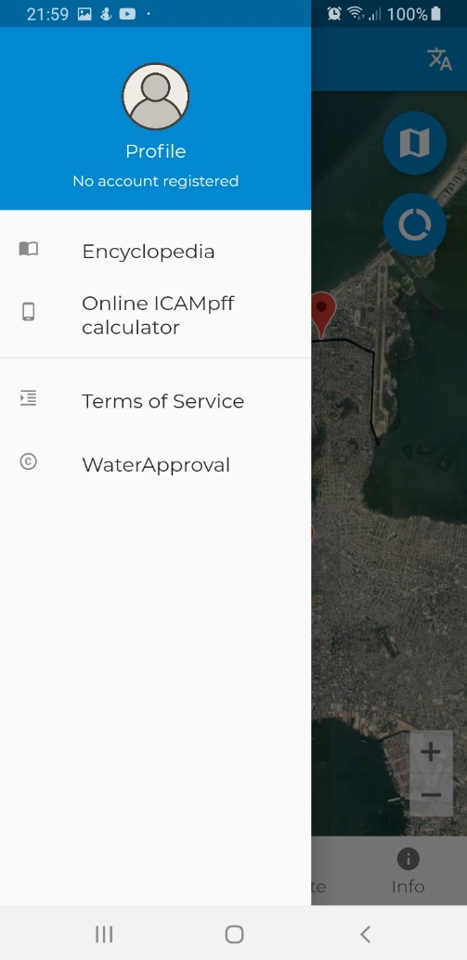
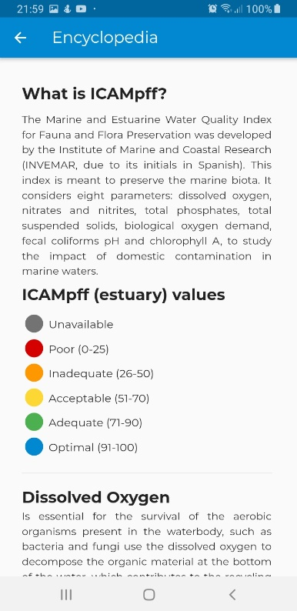
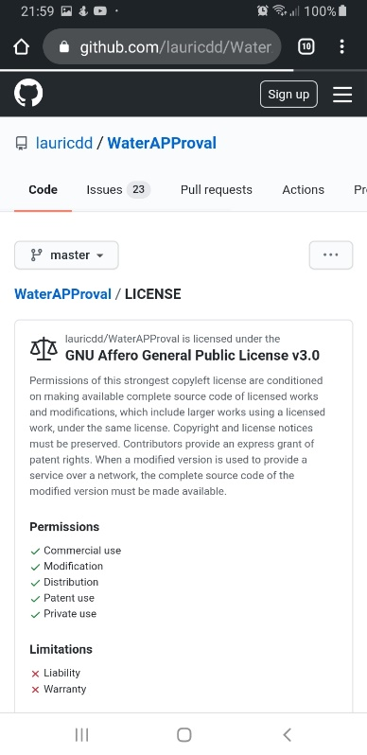
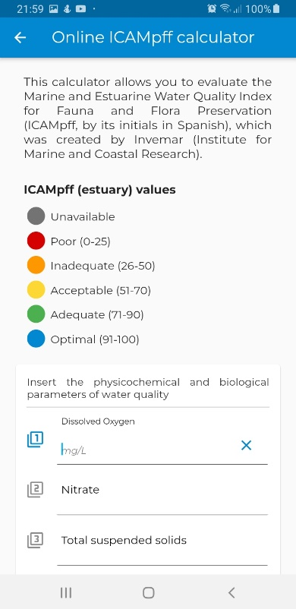
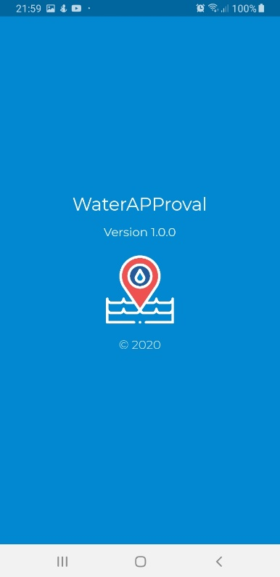
1
3
1
2
3
4
2
4

Slide 14

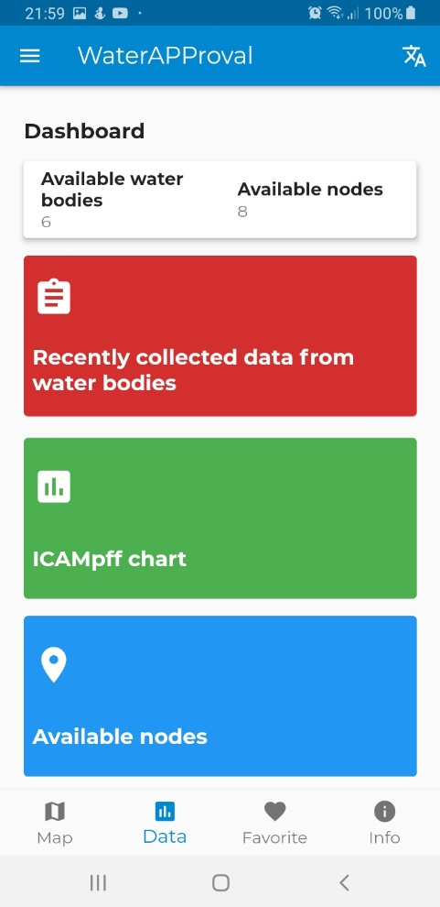
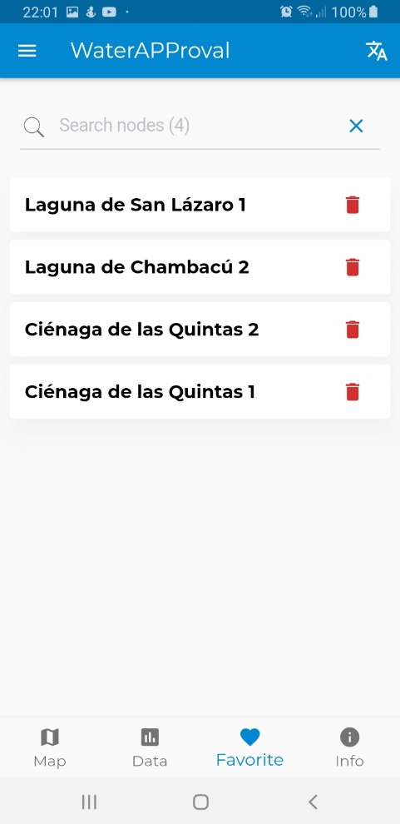
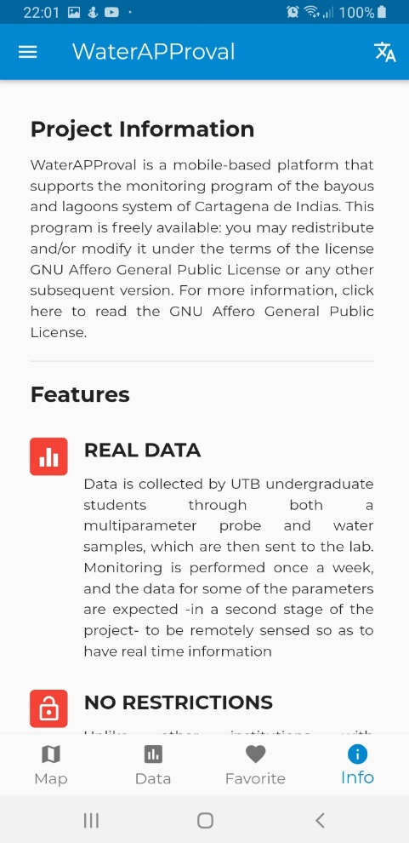
1
2
3
1
2
3

Slide 15

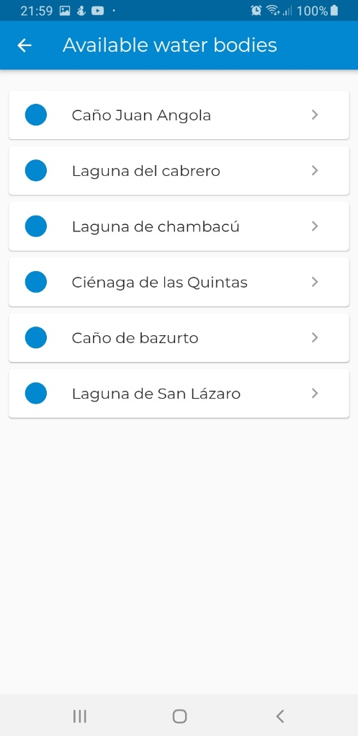
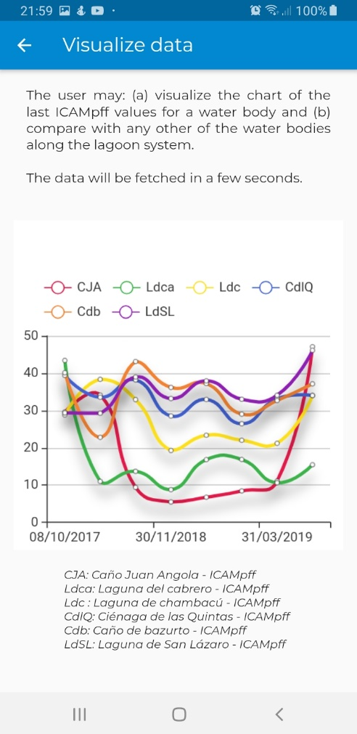
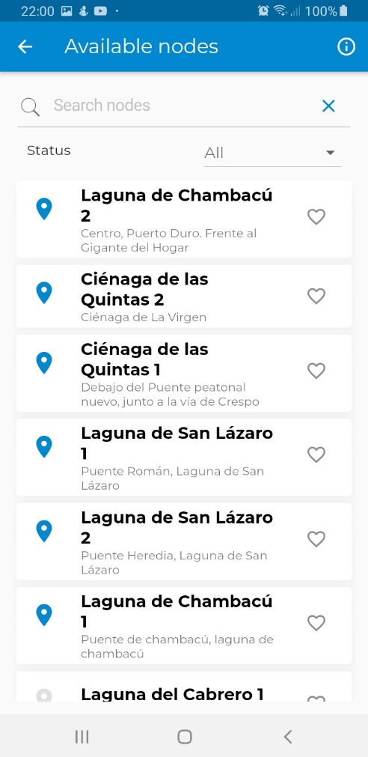
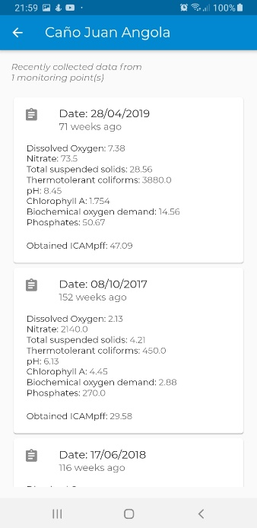
1
1a
1
2
3
2
3
1a

Slide 16
Requirements

Slide 17
Map visualization with nodes and water bodies
Data visualization in different ways
Online ICAMpff calculator
Encyclopedia
Favorites
Multi-language feature
…

Slide 18
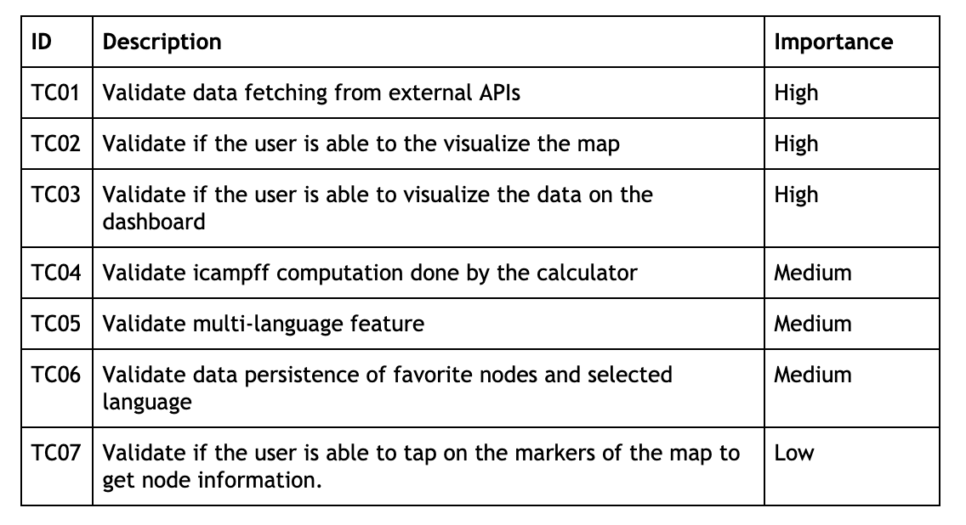
Test plan

Slide 19
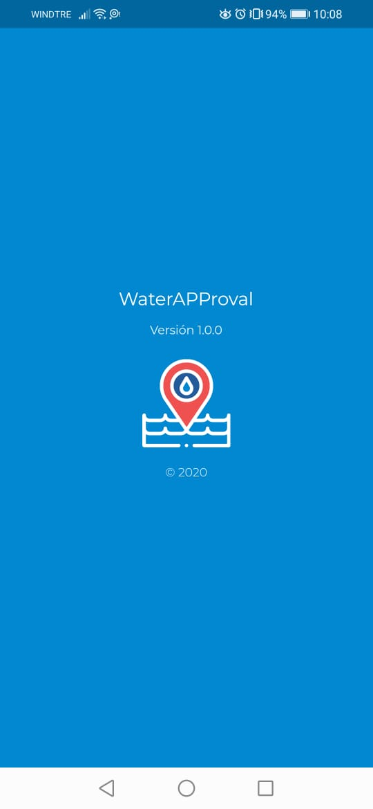
DEMO TIME !

Slide 20

QUESTIONS?

